Slide 1


DevOps for Fun and Profit #2
Workshop 🛠
@GrantBirki + DevOpsDaysLA

Slide 2

Who am I?
@GrantBirki
Security Engineer at GitHub
I like to:
DJ
Code
Play PC games
Solder things
Travel + take pictures

Slide 3
Topics Covered ⚡
Release, deploy, operate, monitor
Using codespaces
What are branch deployments? - Using GitHub Actions
A live demo
Let’s Get Started!

Slide 4
Getting Started 💡
Join: https://discord.gg/UKxAynz4
Send a message with your GitHub username
Check your email for a GitHub Org invite to DevOpsDaysLA
Go to: github.com/DevOpsDaysLA/devops

Slide 5
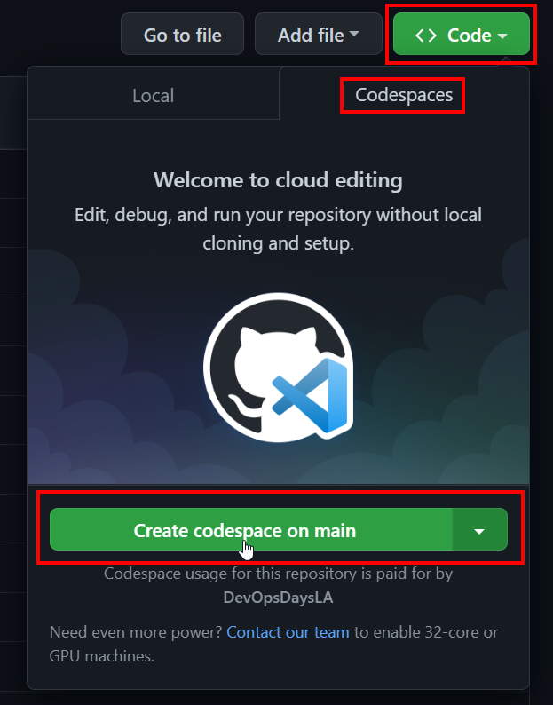
Create a new Codespace
What is GitHub Codespaces?
☁️ Cloud hosted development environment
👯 Consistent, repeatable, and shareable
🚧 Removes the "it works on my machine" barrier
🔥 Saves us from dependency hell
⭐ Allows developers to deploy a dev environment in one-click and begin working on a project

Slide 6
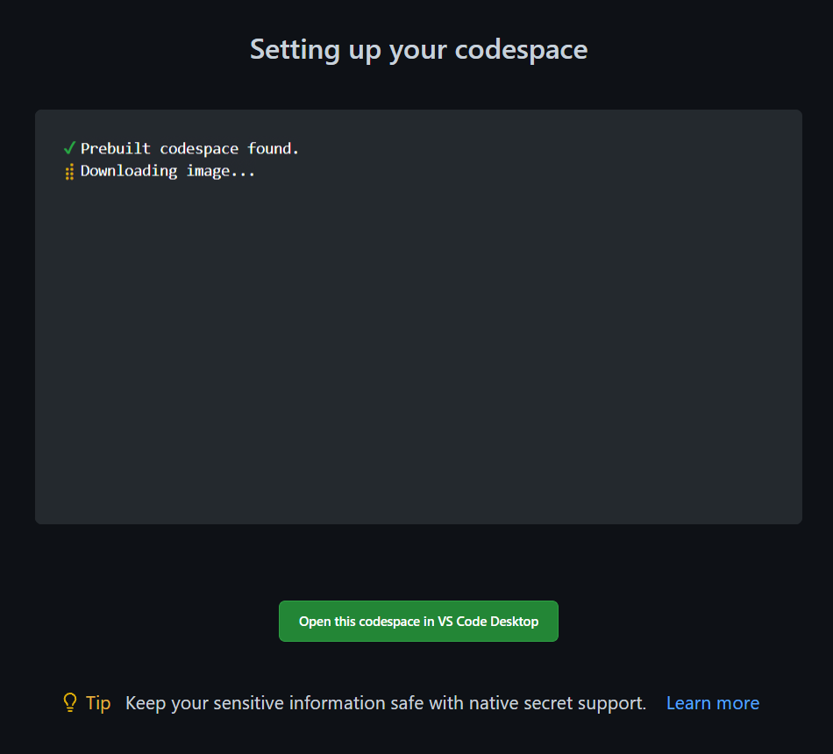
Launching your Codespace 👩‍🚀
You will now attach automatically to your Codespace via your browser. If you have VSC installed, you can optionally attach there instead
All dependencies are pre-installed 🙌

Slide 7
Starting our Application
Setup node modules:
$ npm i
Start the reactle app:
$ npm start
Hooray! You have a working application in just two commands! 🎉

Slide 8
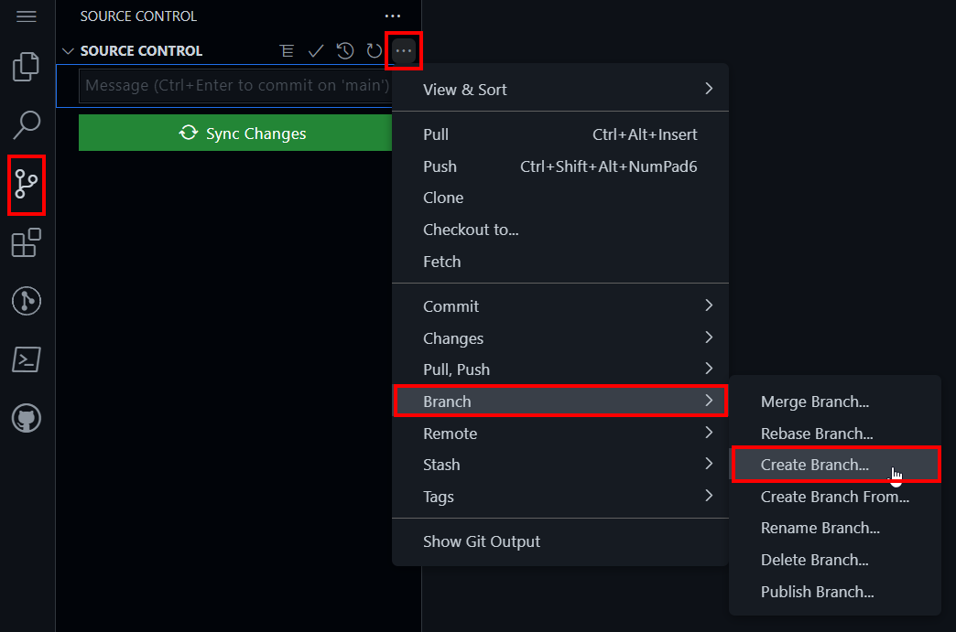
Making a Change to Our App 📝
First, let’s create a new branch

Slide 9
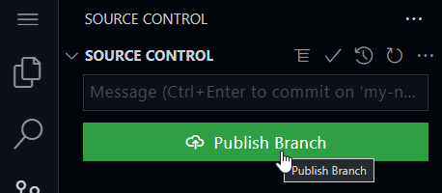
Making a Change to Our App 📝
Name your branch something unique

Slide 10
Making a Change to Our App 📝
Make an edit to any of the “strings” in the following file:
src/constants/strings.ts
Refresh the page and see your changes!

Slide 11
Let’s deploy our change! 🚀
Using the branch-deploy model
For this section, I will walk through deploying the application with Heroku

Slide 12
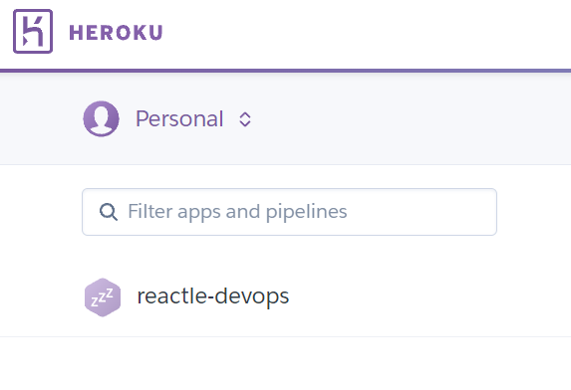
Heroku Setup
Create a Heroku account
Create an application

Slide 13
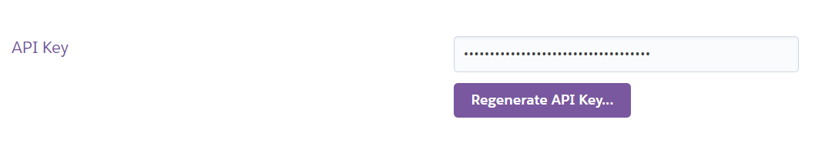
Heroku Setup
Create an API key

Slide 14
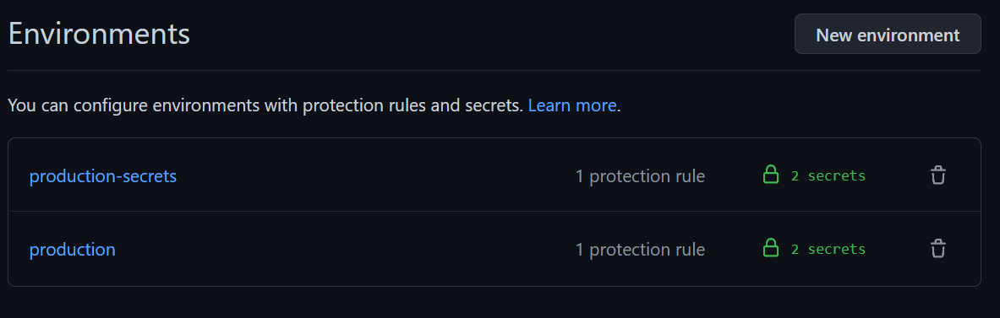
Heroku Setup
Create two new environments for your GitHub repo
Add your API key and Heroku email as secrets

Slide 15
Heroku Setup
Our Heroku setup is complete!
Let’s walk through the branch-deploy model and understand how we can reliably deploy our changes to production

Slide 16
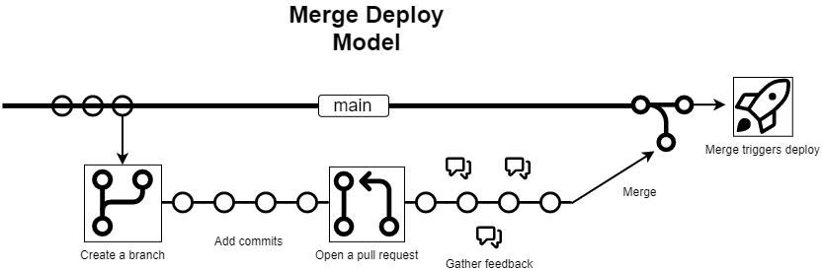
What are Branch Deployments?
First, let’s look at the Merge => Deploy model

Slide 17
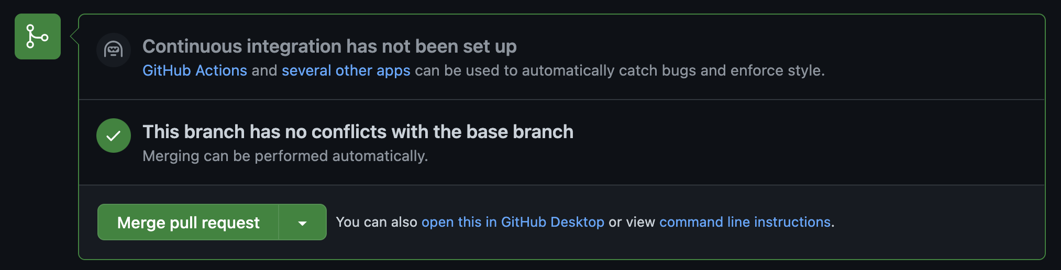
“Merge Deploy” often becomes a “Yolo Deploy”
YOLO!

Slide 18
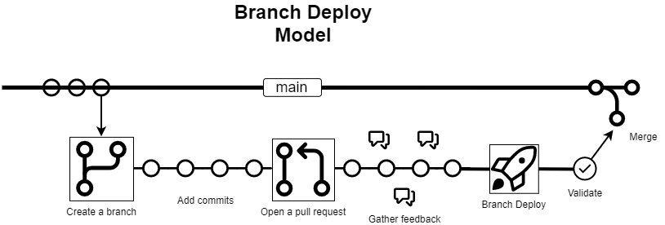
The “Branch Deploy” model

Slide 19
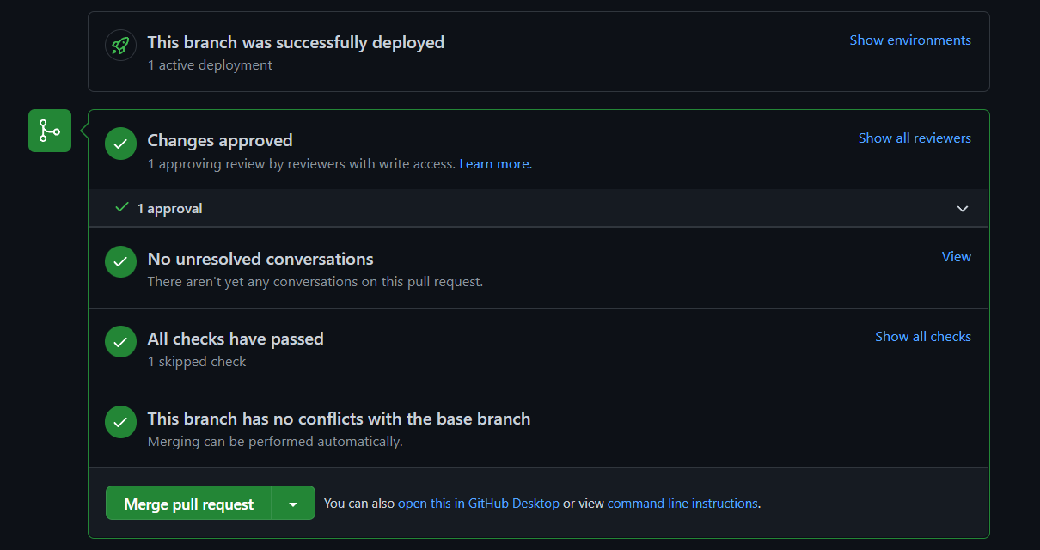
Branch Deploy merge example:

Slide 20
Core Concepts 💡
The main branch is always considered to be a stable and deployable branch
All changes are deployed to production before they are merged to the main branch
To roll back a branch deployment, you deploy the main branch

Slide 21
Why should you use branch deployments? 🤔
The main branch is always stable (rollbacks)
Iterate faster
Excellent confidence in merging changes
Shorter outage windows
Cleaner commit history

Slide 22
How can we enable branch deployments?
Build your own ChatOps solution
Custom integration into your CI system
IssueOps ⭐

Slide 23
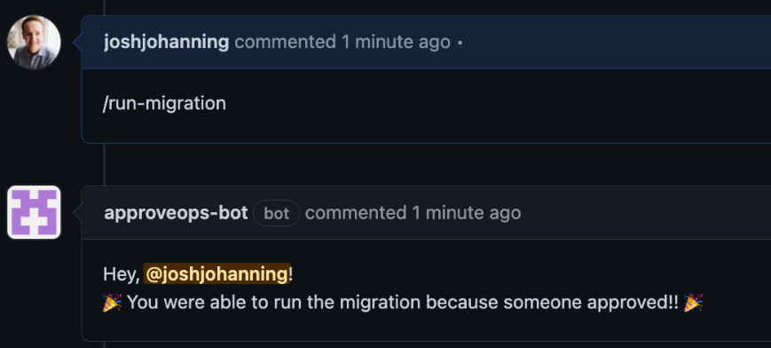
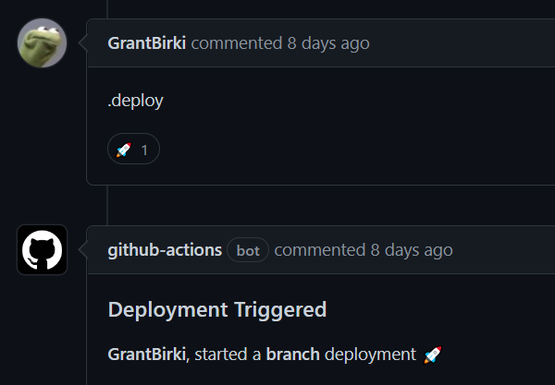
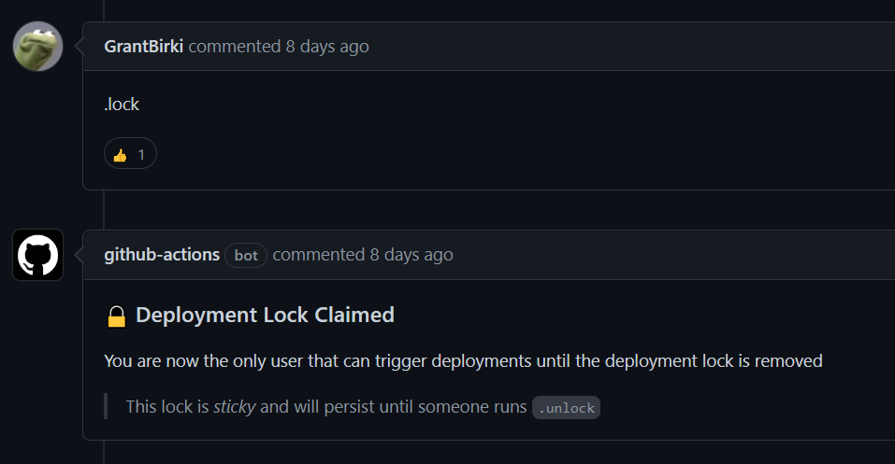
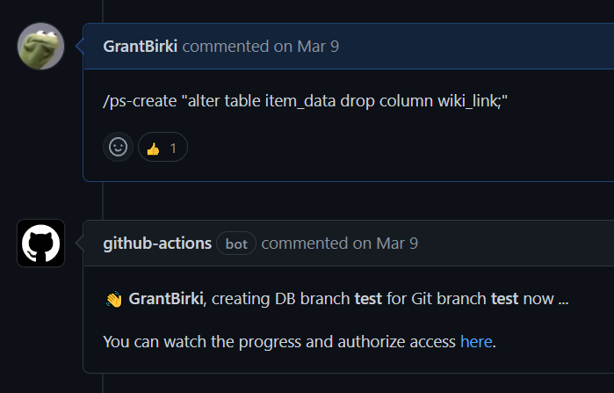
What is IssueOps?
Like ChatOps but on GitHub Issues/Pull Requests

Slide 24
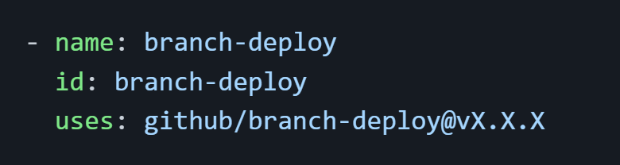
Code Walkthrough 👨‍🔬
Basic config example:

Slide 25
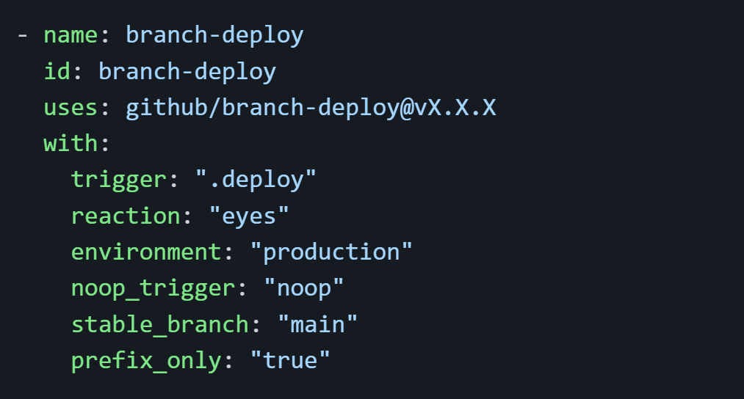
Code Walkthrough 👨‍🔬
Config example (more options):
More options available here: https://github.com/github/branch-deploy#inputs-

Slide 26
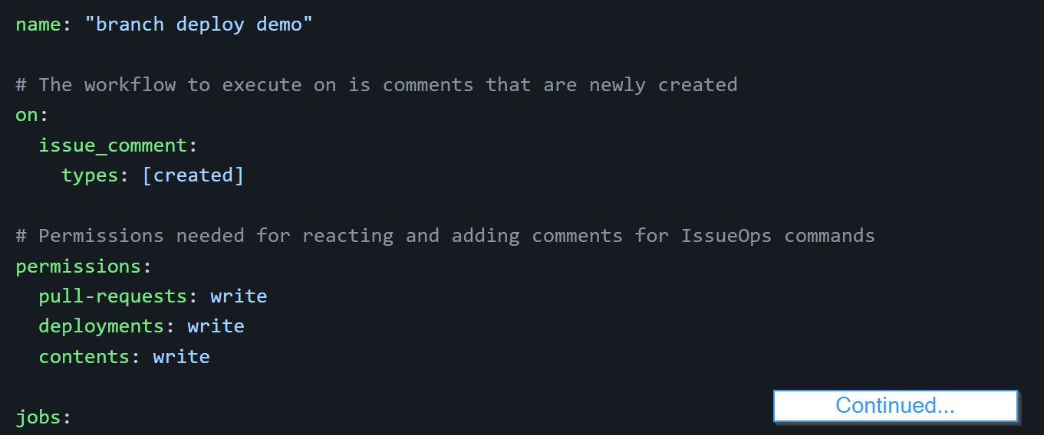
Code Walkthrough 👨‍🔬
1. Setting up the Action workflow:

Slide 27
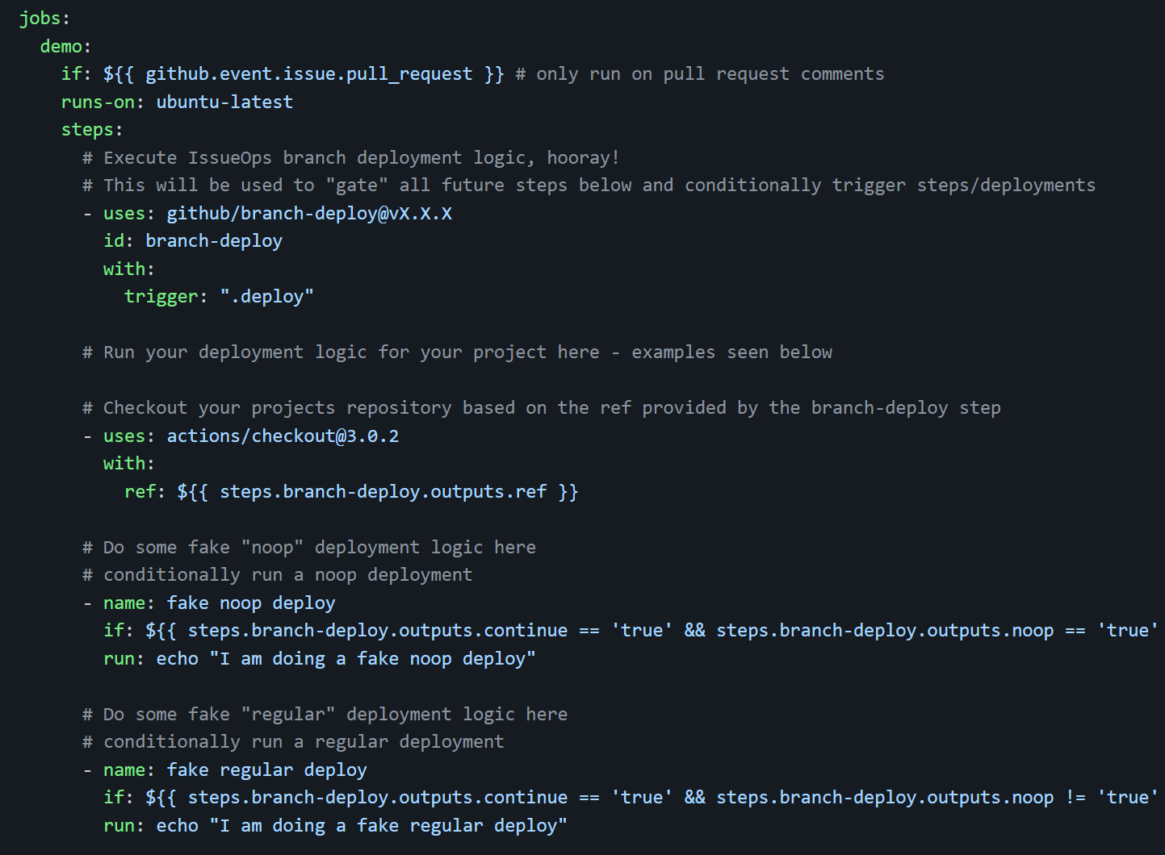
Code Walkthrough 👨‍🔬
2. Using the Action:

Slide 28
Source Code! 💻
github.com/github/branch-deploy
Enough talk, lets deploy!

Slide 29
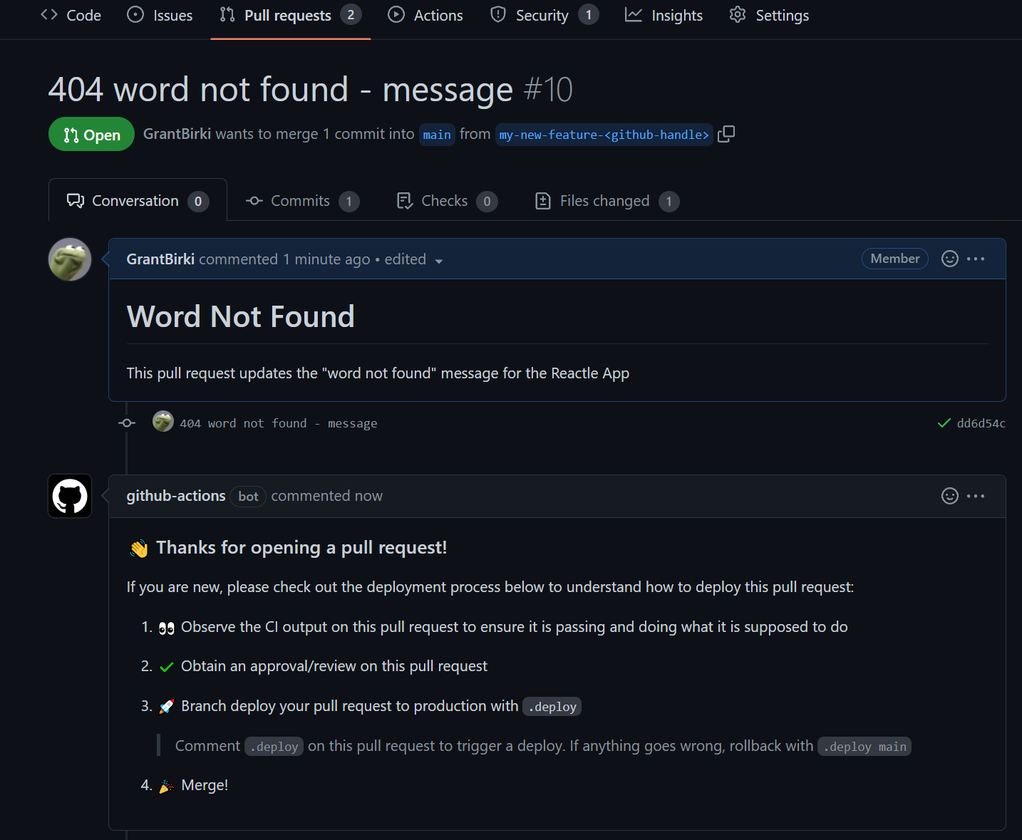
Deploy 🚀
Open a new pull request with your changes

Slide 30
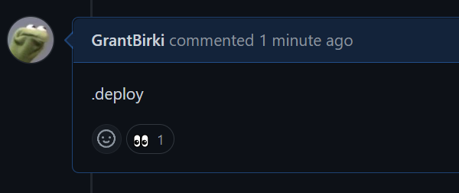
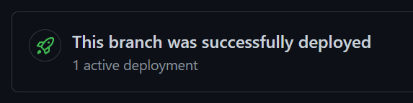
Deploy 🚀
Comment .deploy on your PR and watch your changes ship to production

Slide 31
Deploy 🚀
Check it out!
reactle-devops.herokuapp.com

Slide 32
Deploy 🚀
Your turn!
Any volunteers who want to deploy their pull request?

Slide 33
Deploy 🚀
What if something goes wrong?
Let’s roll back:
.deploy main

Slide 34
Monitoring 🔭
How can we observe our web app?

Slide 35
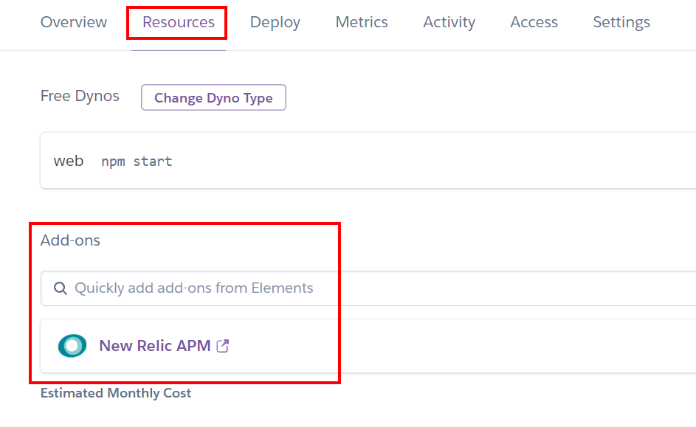
Monitoring 🔭
One-click New Relic APM integration:

Slide 36
Monitoring 🔭
Add a JS snippet:
github.com/DevOpsDaysLA/devops/pull/7

Slide 37
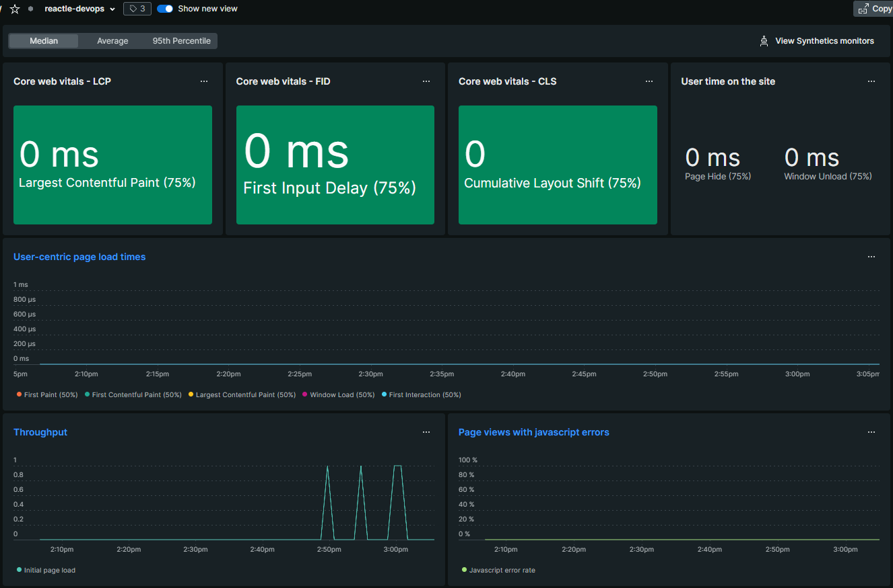
Monitoring 🔭
Dashboards
oooh colors

Slide 38
Security 🔒
Let’s check for vulnerabilities
Build a container:
$ docker build -t reactle:latest -f docker/app/Dockerfile .
Run trivy:
$ trivy image reactle:latest

Slide 39

Security 🔒
It looks like there is a CVE with terser…
I wonder if dependabot could help? 🤔
CVE = Common Vulnerabilities and Exposures

Slide 40
Security 🔒
Let’s use dependabot to fix our CVE
github.com/DevOpsDaysLA/devops/pull/9

Slide 41
What have we learned? 📚
How to use Codespaces and why
How to leverage branch deployments
How to enable basic monitoring
How to resolve a CVE

Slide 42
Additional Resources 📚
Branch Deploy Blog Post
github.com/github/branch-deploy
Getting started on Heroku
Heroku + New Relic APM
Trivy - All purpose security scanning utility

Slide 43

THANK YOU!
@GrantBirki + DevOpsDaysLA

